Slide 1
Rust for Freshmen
How we can use Rust to instill good habits in new programmers.
Colton Donnelly
Rust for Freshmen
Twitter: @cdmistman
GitHub: cdmistman
RustFest Global 2020

Slide 2
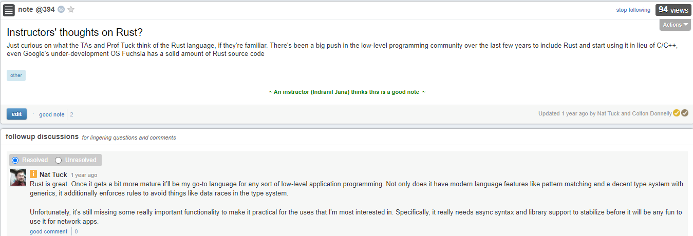
Introduction
Computer Science & Business Administration student at Northeastern University
Computer Systems course taught in C
Editor for This Week in Rust
Colton Donnelly
Rust for Freshmen
Twitter: @cdmistman
GitHub: cdmistman
RustFest Global 2020

Slide 3
Goal
Design a freshman-level CS course taught in Rust
Enable students with Rust’s tooling
Error messages
Testing and documentation
Avoid teaching out-of-scope topics
Stack vs heap
Thread safety
Lifetimes
Macros (println and format are fine)
Cargo (dependencies, compiler configuration)
Colton Donnelly
Rust for Freshmen
Twitter: @cdmistman
GitHub: cdmistman
RustFest Global 2020

Slide 4
Fundamentals of Computer Science II
(“Fundies 2”)
Object-oriented programming with Java
Fundies 1 taught in Racket
Good habits
Naming conventions
Documentation
Unit testing
Encapsulation
No introduction to null (yet)
Homework submitted as library files
Testing library executes unit tests
Animation library executes code
Colton Donnelly
Rust for Freshmen
Twitter: @cdmistman
GitHub: cdmistman
RustFest Global 2020

Slide 5
Part 1: Introduction to Rust
Basic types
Numbers (int => i32, double => f32)
Booleans
Strings
Data types: C-style structs
Implementation blocks
Constructors
Methods
Functions
References
Colton Donnelly
Rust for Freshmen
Twitter: @cdmistman
GitHub: cdmistman
RustFest Global 2020

Slide 6
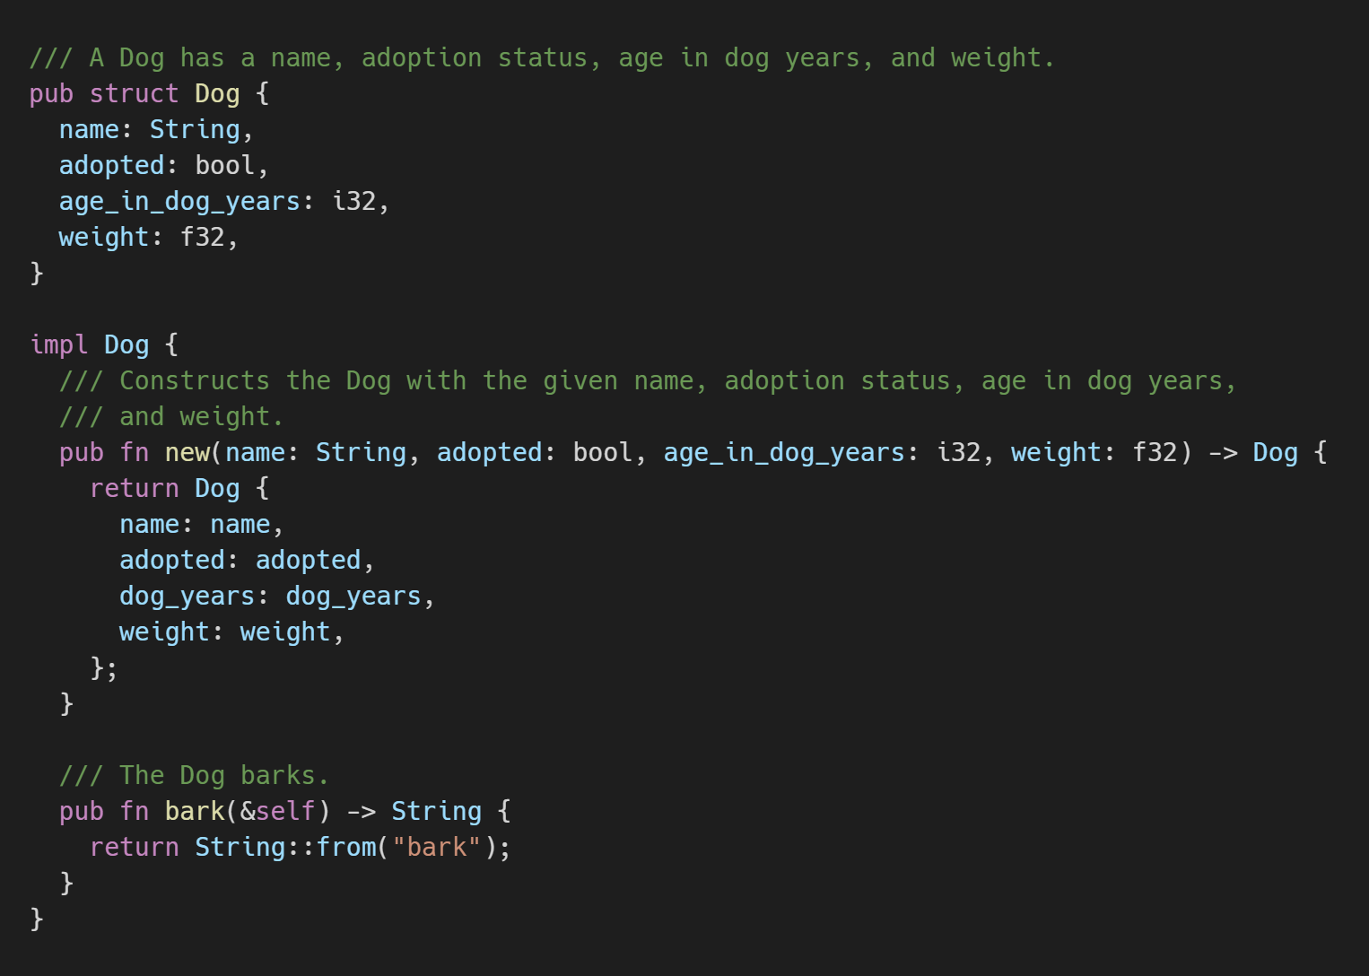
Part 1: Introduction to Rust
Colton Donnelly
Rust for Freshmen
Twitter: @cdmistman
GitHub: cdmistman
RustFest Global 2020

Slide 7
Part 2: Abstraction
(Java interface)
Traits to define shared behavior
Colton Donnelly
Rust for Freshmen
Twitter: @cdmistman
GitHub: cdmistman
RustFest Global 2020

Slide 8
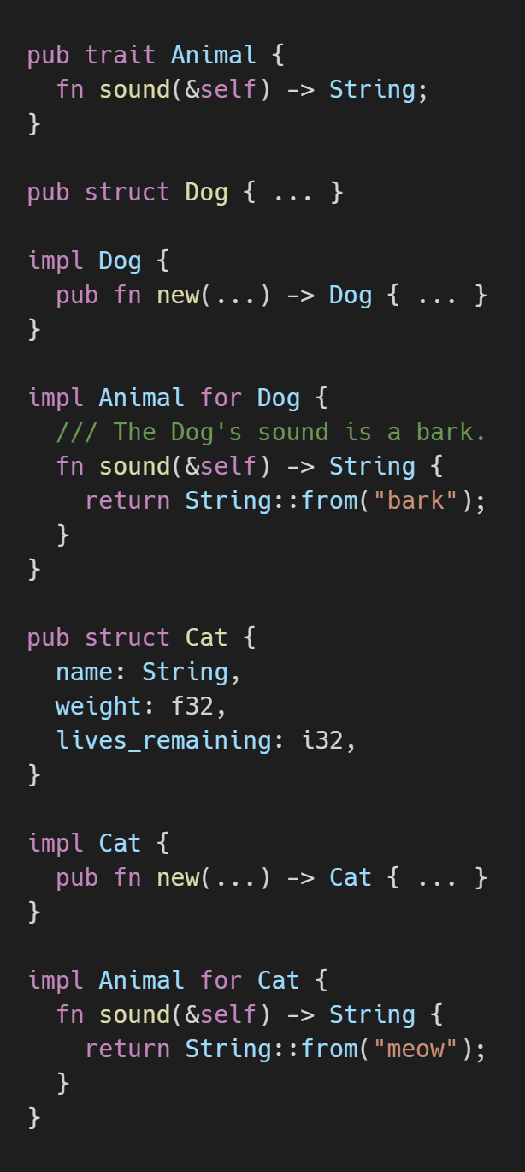
Part 2: Abstraction
(Java interface)
Colton Donnelly
Rust for Freshmen
Twitter: @cdmistman
GitHub: cdmistman
RustFest Global 2020

Slide 9
Part 2: Abstraction
(Java abstract class)
Traits to define shared behavior
Possible to define default behavior
Colton Donnelly
Rust for Freshmen
Twitter: @cdmistman
GitHub: cdmistman
RustFest Global 2020

Slide 10
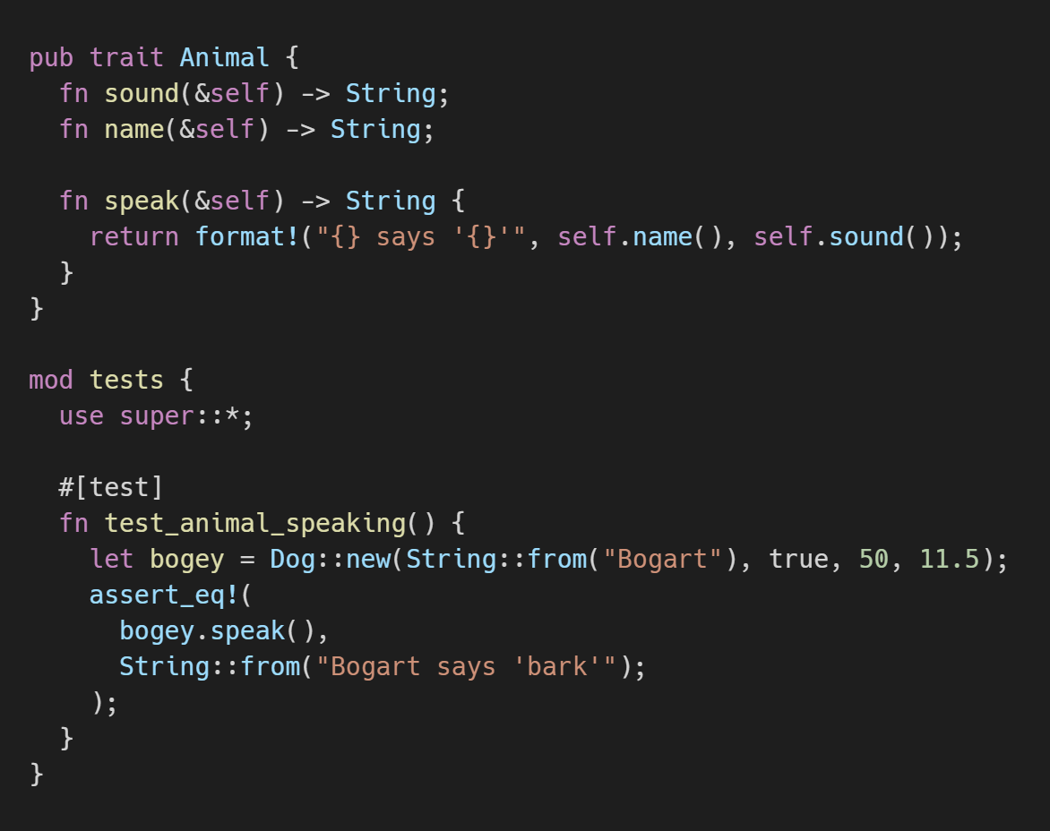
Part 2: Abstraction
(Java abstract class)
Colton Donnelly
Rust for Freshmen
Twitter: @cdmistman
GitHub: cdmistman
RustFest Global 2020

Slide 11
Part 2: Abstraction
(Java abstract class)
Traits to define shared behavior
Possible to define default behavior
Shared objects to define shared data
Colton Donnelly
Rust for Freshmen
Twitter: @cdmistman
GitHub: cdmistman
RustFest Global 2020

Slide 12
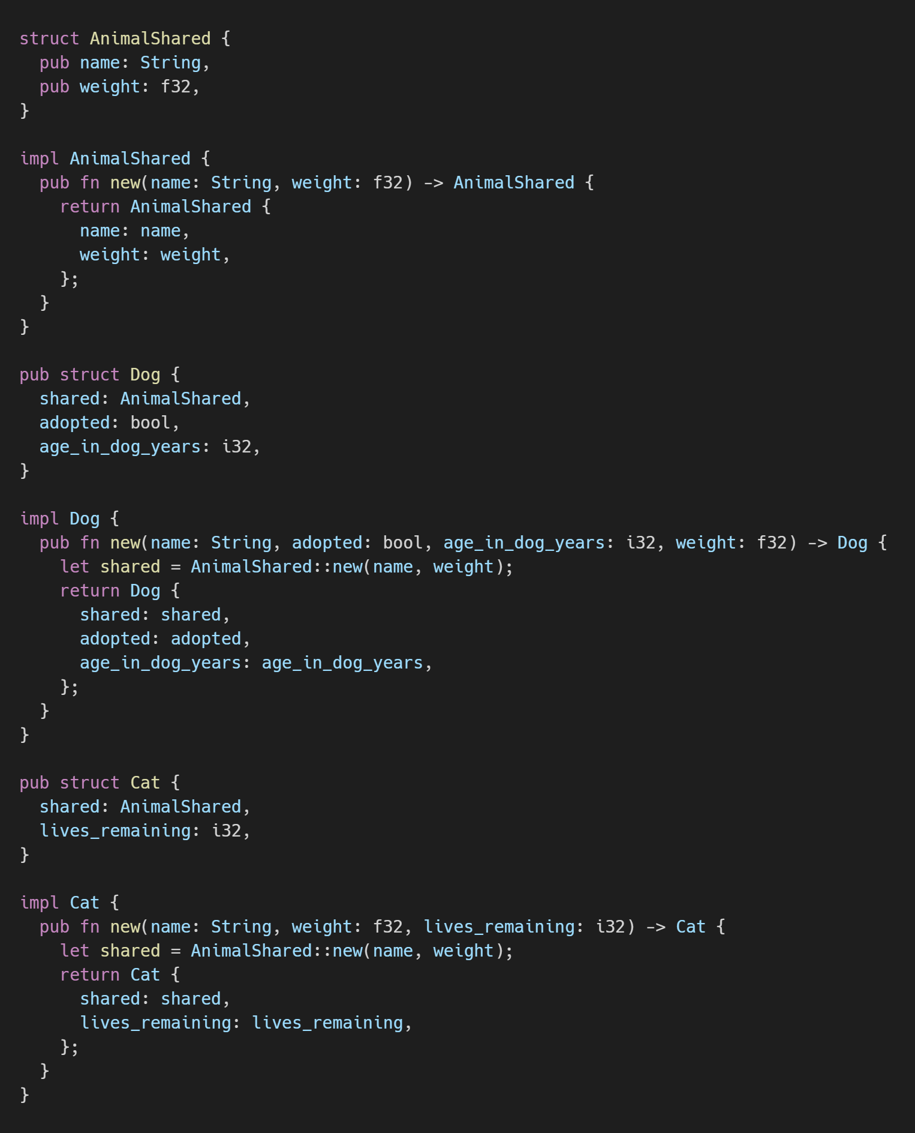
Part 2: Abstraction
(Java abstract class)
Colton Donnelly
Rust for Freshmen
Twitter: @cdmistman
GitHub: cdmistman
RustFest Global 2020

Slide 13
Part 2: Abstraction
(dynamic dispatch)
Traits to define shared behavior
Possible to define default behavior
Shared objects to define shared data
Dynamic dispatch to act on shared behavior
Colton Donnelly
Rust for Freshmen
Twitter: @cdmistman
GitHub: cdmistman
RustFest Global 2020

Slide 14
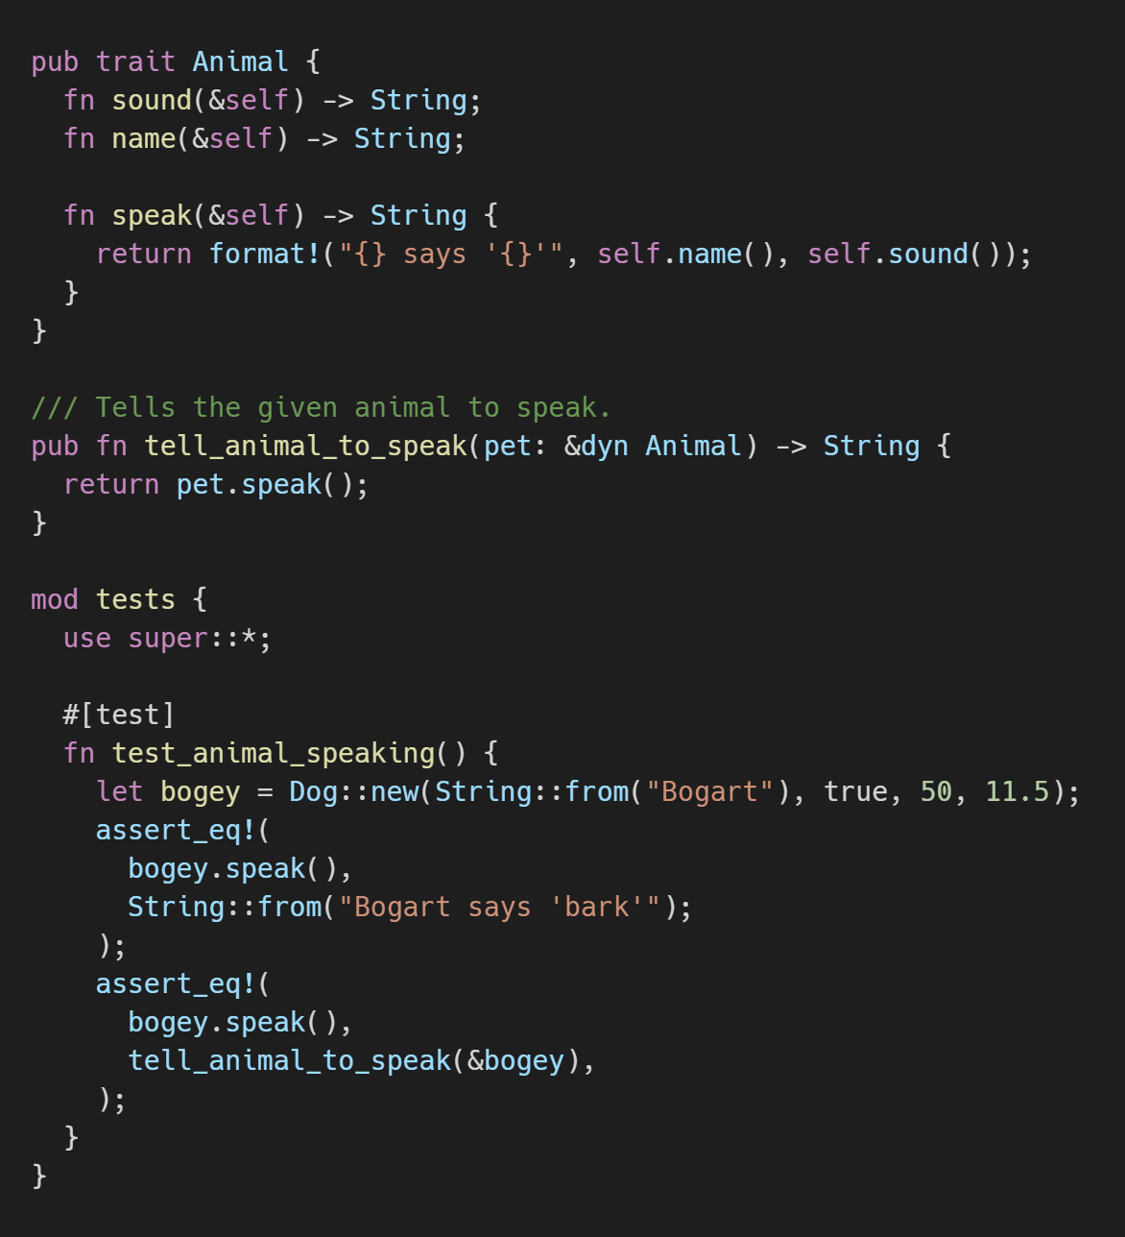
Part 2: Abstraction
(dynamic dispatch)
Colton Donnelly
Rust for Freshmen
Twitter: @cdmistman
GitHub: cdmistman
RustFest Global 2020

Slide 15
Part 2: Abstraction
(generic types)
Traits to define shared behavior
Possible to define default behavior
Shared objects to define shared data
Dynamic dispatch to act on shared behavior
Generics to contain different kinds of data
Colton Donnelly
Rust for Freshmen
Twitter: @cdmistman
GitHub: cdmistman
RustFest Global 2020

Slide 16
Part 2: Abstraction
(generic types)
Problem!
Colton Donnelly
Rust for Freshmen
Twitter: @cdmistman
GitHub: cdmistman
RustFest Global 2020

Slide 17
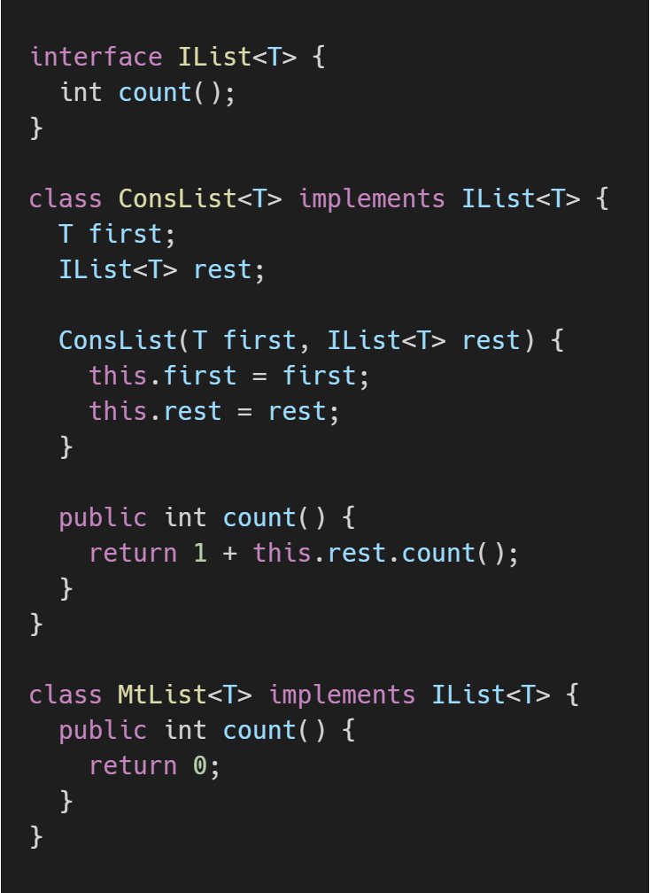
Part 2: Abstraction
(generic types)
Problem!
Colton Donnelly
Rust for Freshmen
Twitter: @cdmistman
GitHub: cdmistman
RustFest Global 2020

Slide 18
Part 2: Abstraction
(generic types)
Problem!
This won’t work in Rust:
Colton Donnelly
Rust for Freshmen
Twitter: @cdmistman
GitHub: cdmistman
RustFest Global 2020

Slide 19
Part 2: Abstraction
(generic types)
Problem!
This won’t work in Rust:
Monads are real in Rust
Colton Donnelly
Rust for Freshmen
Twitter: @cdmistman
GitHub: cdmistman
RustFest Global 2020

Slide 20
Part 2: Abstraction
(generic types)
Problem!
This won’t work in Rust:
Monads are real in Rust
Recursive data definition
Colton Donnelly
Rust for Freshmen
Twitter: @cdmistman
GitHub: cdmistman
RustFest Global 2020

Slide 21
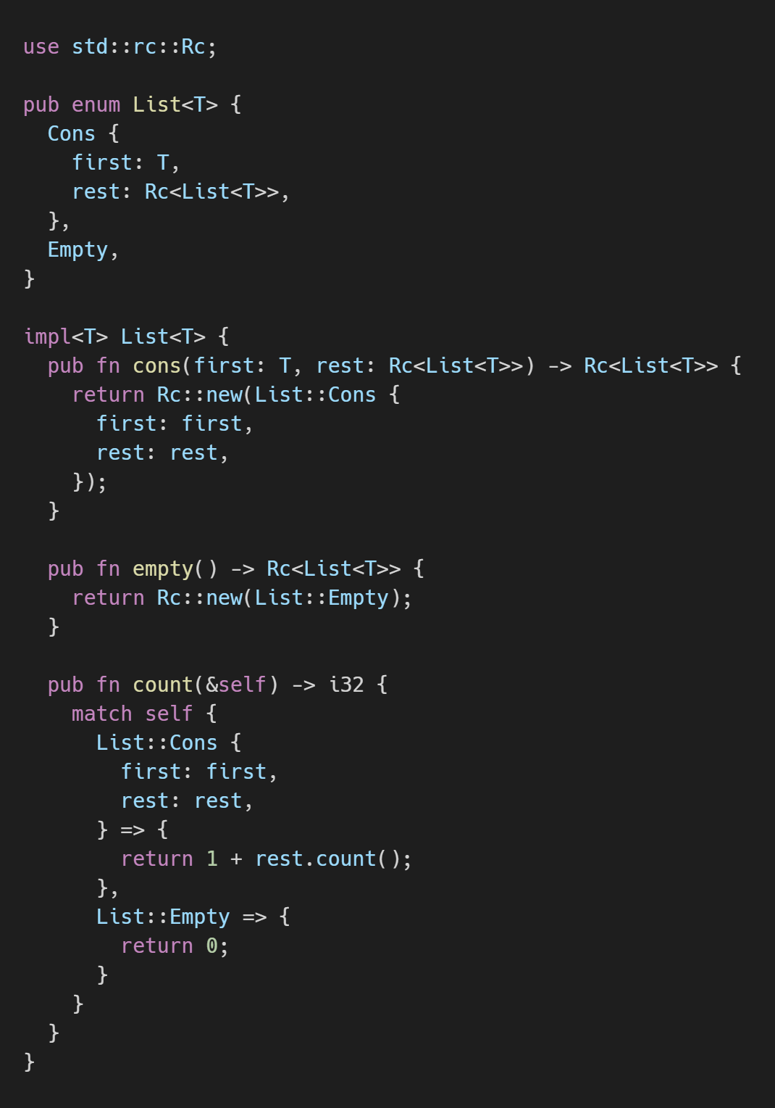
Part 2: Abstraction
(generic types)
Colton Donnelly
Rust for Freshmen
Twitter: @cdmistman
GitHub: cdmistman
RustFest Global 2020

Slide 22
Part 2: Abstraction
(generic types)
Problem!
Colton Donnelly
Rust for Freshmen
Twitter: @cdmistman
GitHub: cdmistman
RustFest Global 2020

Slide 23
Part 2: Abstraction
(generic types)
Problem!
We must use heap allocation
Colton Donnelly
Rust for Freshmen
Twitter: @cdmistman
GitHub: cdmistman
RustFest Global 2020

Slide 24
Part 2: Abstraction
(function objects)
Traits to define shared behavior
Possible to define default behavior
Shared objects to define shared data
Dynamic dispatch to act on shared behavior
Generics to contain different kinds of data
Problem: heap allocation
Function objects to add to existing behavior
Colton Donnelly
Rust for Freshmen
Twitter: @cdmistman
GitHub: cdmistman
RustFest Global 2020

Slide 25
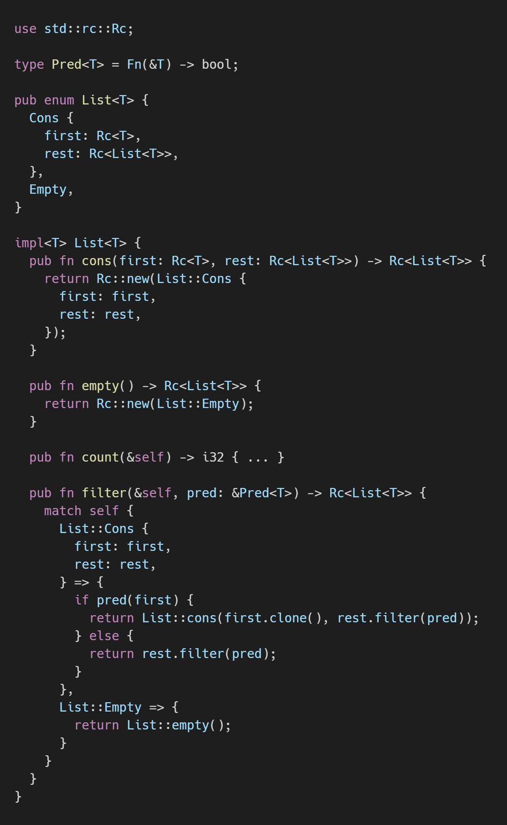
Part 2: Abstraction
(function objects)
Colton Donnelly
Rust for Freshmen
Twitter: @cdmistman
GitHub: cdmistman
RustFest Global 2020

Slide 26
Part 3: Error Handling
Currently taught using Java Exceptions
When to throw Exceptions
Throwing the right Exception
Catching Exceptions
Use Rust’s Result instead
Future advantage: Option
Colton Donnelly
Rust for Freshmen
Twitter: @cdmistman
GitHub: cdmistman
RustFest Global 2020

Slide 27
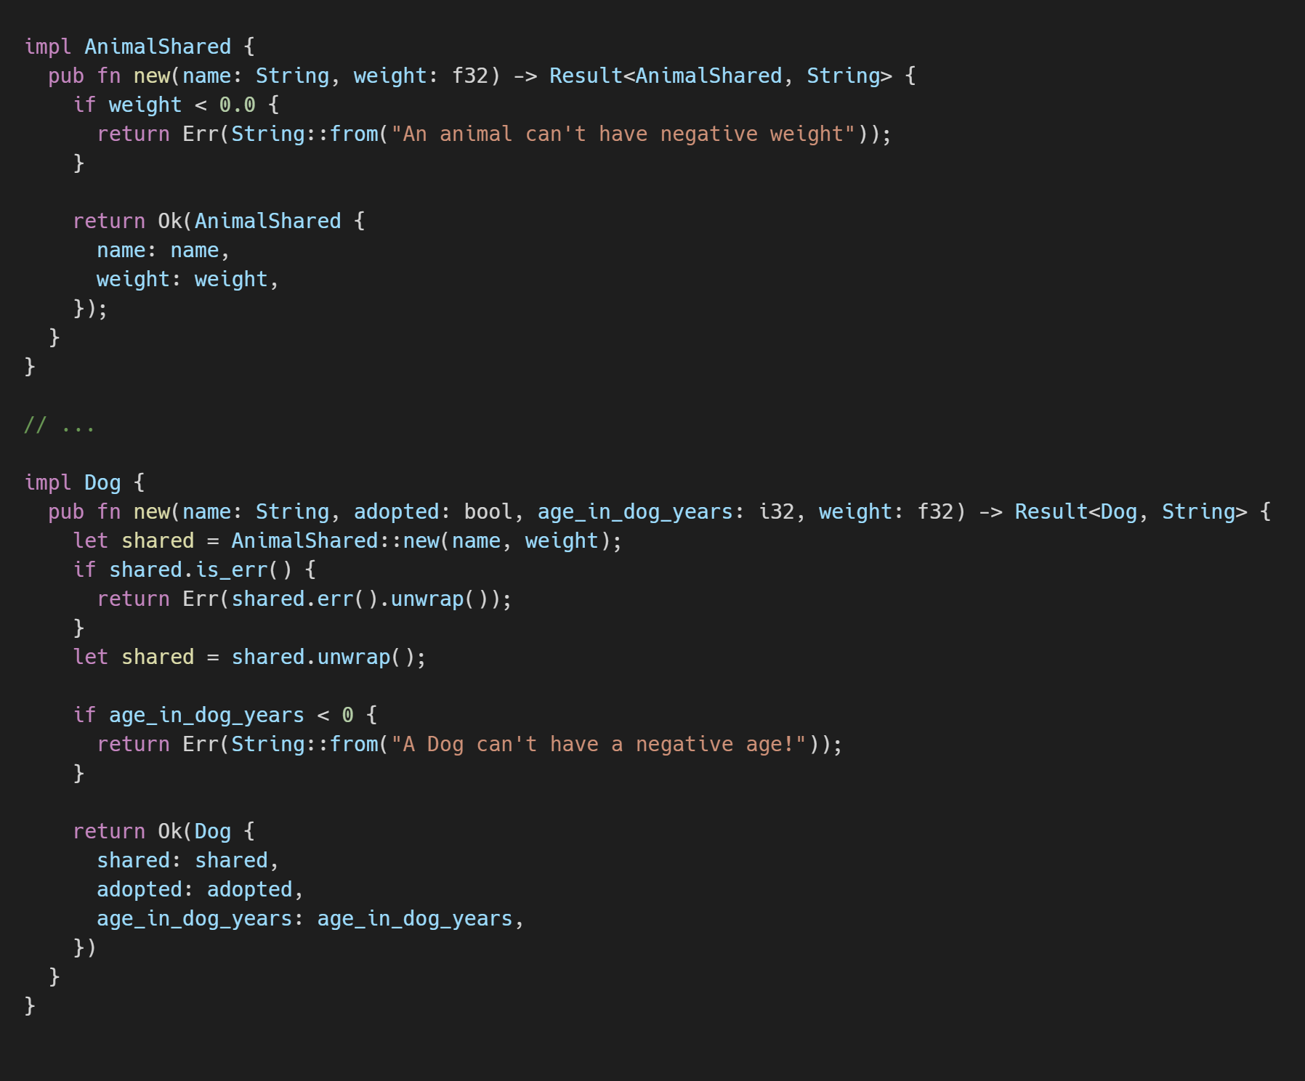
Part 3: Error Handling
Colton Donnelly
Rust for Freshmen
Twitter: @cdmistman
GitHub: cdmistman
RustFest Global 2020

Slide 28
Part 4: Sameness of data
Data is the same when it has the following properties
Reflexivity (a == a)
Symmetry (a == b && b == a)
Transitivity (a == b && b == c && a == c)
Colton Donnelly
Rust for Freshmen
Twitter: @cdmistman
GitHub: cdmistman
RustFest Global 2020

Slide 29
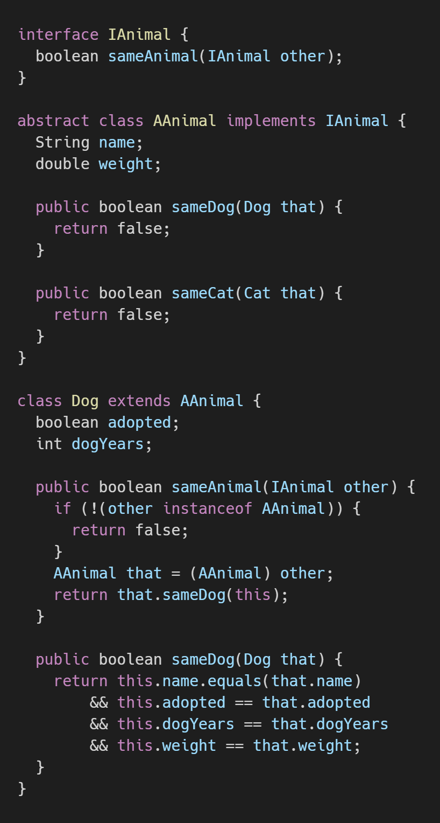
Part 4: Sameness of data
Colton Donnelly
Rust for Freshmen
Twitter: @cdmistman
GitHub: cdmistman
RustFest Global 2020

Slide 30
Part 4: Sameness of data
Problem!
Colton Donnelly
Rust for Freshmen
Twitter: @cdmistman
GitHub: cdmistman
RustFest Global 2020

Slide 31
Part 4: Sameness of data
Problem!
Checking the type of an Object
Colton Donnelly
Rust for Freshmen
Twitter: @cdmistman
GitHub: cdmistman
RustFest Global 2020

Slide 32
Part 4: Sameness of data
Problem!
Checking the type of an Object
Rust’s type erasure
Colton Donnelly
Rust for Freshmen
Twitter: @cdmistman
GitHub: cdmistman
RustFest Global 2020

Slide 33
Part 4: Sameness of data
Data is the same when it has the following properties
Reflexivity (a == a)
Symmetry (a == b && b == a)
Transitivity (a == b && b == c && a == c)
Problems
No “instanceof” in Rust
Rust erases concrete types of trait objects
Colton Donnelly
Rust for Freshmen
Twitter: @cdmistman
GitHub: cdmistman
RustFest Global 2020

Slide 34
Part 4: Sameness of data
Data is the same when it has the following properties
Reflexivity (a == a)
Symmetry (a == b && b == a)
Transitivity (a == b && b == c && a == c)
Problems
No “instanceof” in Rust
Rust erases concrete types of trait objects
Advantage?
Programmers should only use what they need
Avoid downcasting for specific behavior
Only check for equality when an object is the same type (with Eq)
Colton Donnelly
Rust for Freshmen
Twitter: @cdmistman
GitHub: cdmistman
RustFest Global 2020

Slide 35
Fixing our problems
Monadic behavior
Enum is our only way to do this
Colton Donnelly
Rust for Freshmen
Twitter: @cdmistman
GitHub: cdmistman
RustFest Global 2020

Slide 36
Fixing our problems
Monadic behavior
Enum is our only way to do this
Sameness of trait objects
Is this even problematic?
Colton Donnelly
Rust for Freshmen
Twitter: @cdmistman
GitHub: cdmistman
RustFest Global 2020

Slide 37
Fixing our problems
Monadic behavior
Enum is our only way to do this
Sameness of trait objects
Is this even problematic?
Recursive data definitions without teaching stack vs heap
???
Colton Donnelly
Rust for Freshmen
Twitter: @cdmistman
GitHub: cdmistman
RustFest Global 2020

Slide 38
Fixing our problems
Colton Donnelly
Rust for Freshmen
Twitter: @cdmistman
GitHub: cdmistman
RustFest Global 2020

Slide 39
Fixing our problems
Colton Donnelly
Rust for Freshmen
Twitter: @cdmistman
GitHub: cdmistman
Problem!
RustFest Global 2020

Slide 40
Fixing our problems
Colton Donnelly
Rust for Freshmen
Twitter: @cdmistman
GitHub: cdmistman
Problem!
Too much magic - the course should be WYSIWG
RustFest Global 2020

Slide 41
Honorable mentions
Topic: Loops
Topic: Mutability
Topic: Algorithms
Problem: Animation library
Immature GUI ecosystem
WebAssembly possibility?
Problem: Cargo
Custom tool?
Topics for future classes
Lifetimes
Threads
Unsafe
Colton Donnelly
Rust for Freshmen
Twitter: @cdmistman
GitHub: cdmistman
RustFest Global 2020

Slide 42
Is this course viable?
Advantages
Forcing good habits with Rust (applicable to other languages)
Future concepts will enforce good habits
Helpful compiler
Disadvantages
A lot of work must be done first (Animation, Cargo replacement)
Enums are unavoidable (Rust Does It Differently™)
Must introduce pass-by-reference
Most languages have this by default
Colton Donnelly
Rust for Freshmen
Twitter: @cdmistman
GitHub: cdmistman
RustFest Global 2020

Slide 43
Thank you for watching!
Colton Donnelly
Rust for Freshmen
Twitter: @cdmistman
GitHub: cdmistman
RustFest Global 2020

